Slide 1
Considerations of the Brazilian Jiu Jitsu and Mixed
Martial Arts Athlete: What the ATC Needs to Know
Ethan M. Kreiswirth PhD. ATC
Christopher Ingstad PT. DPT. MTC. ATC

Slide 2
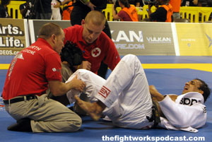
What is Brazilian Jiu Jitsu?
A modern combat martial art that engages in ground fighting techniques which employ joint locks to submit an opponent
2

Slide 3
What is a Submission Joint Lock
A joint lock is defined as a joint being taken to its terminal end range where the athlete will tap with his hand on the mat or opponent to end a match
Terminal end range = mechanism of Injury
Sports similar to BJJ include Japanese jiu jitsu, collegiate wrestling, judo, and mixed martial arts (MMA).
3

Slide 4
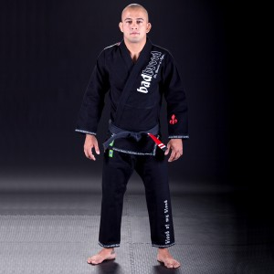
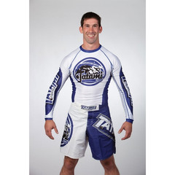
Two Types of BJJ
Gi and No-Gi

Slide 5
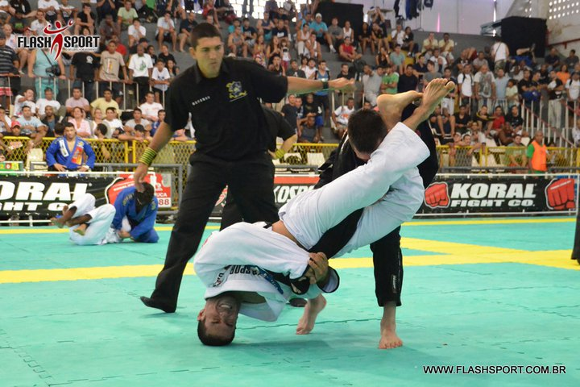
Arm Lock (elbow hyperextension)
5

Slide 6
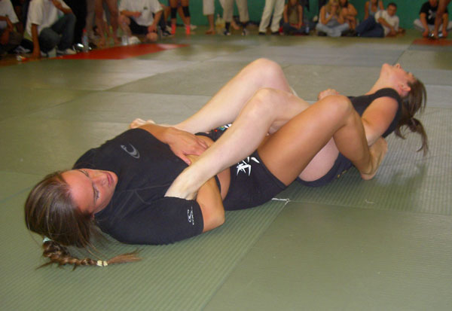
Ankle Lock (hyper plantar flexion)
6

Slide 7
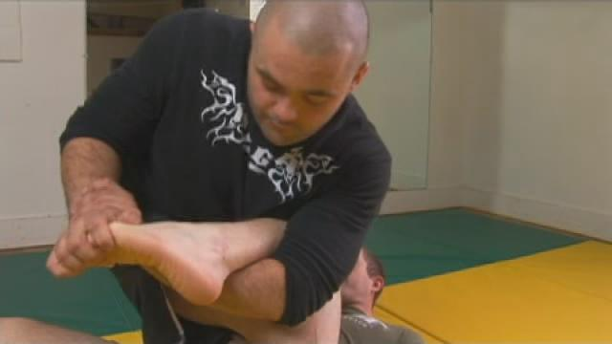
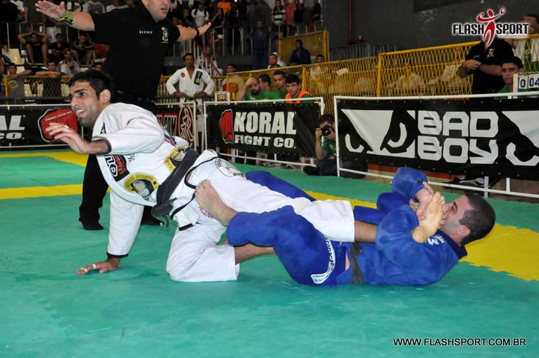
Toe Hold (plantar flexion inversion)
7

Slide 8
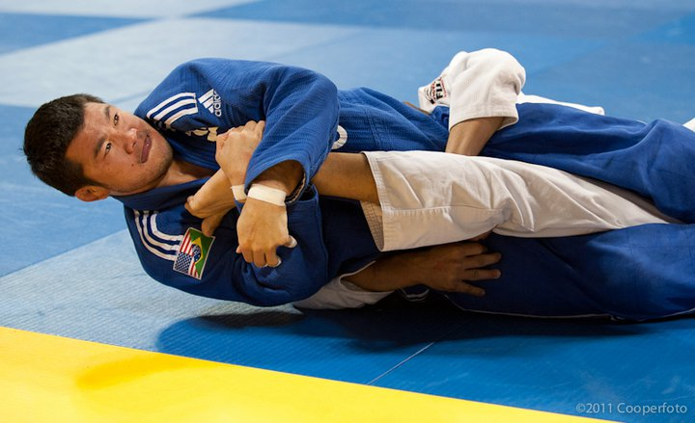
Knee Lock (knee hyperextension)
8

Slide 9
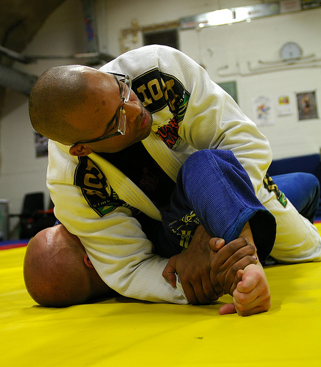
Shoulder Lock (glenohumural abduction with external rotation)
9

Slide 10
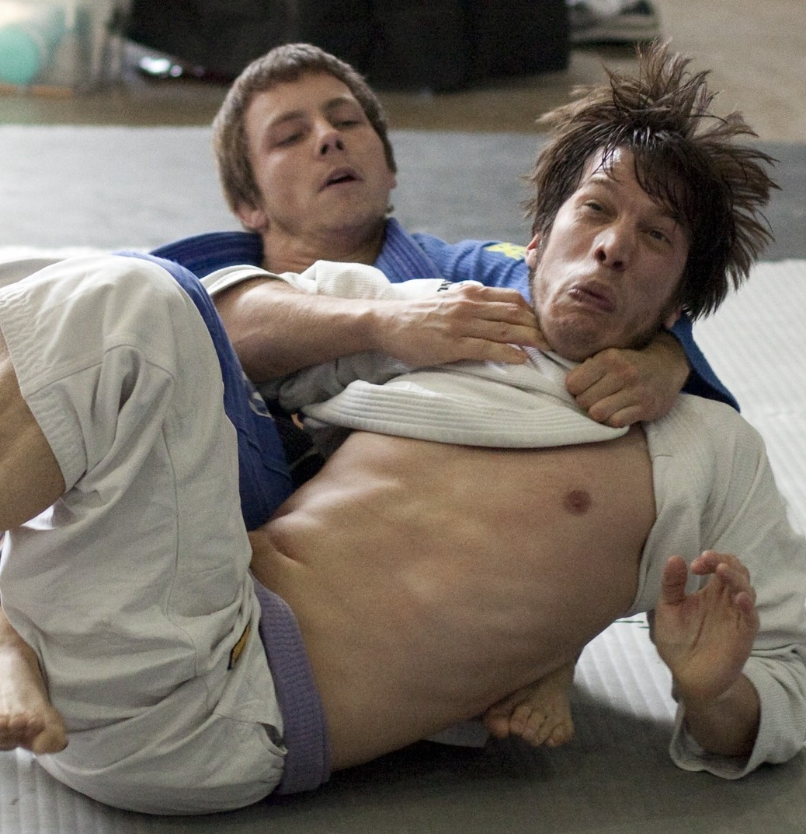
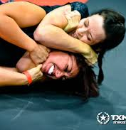
Gi and No Gi Choke Holds

Slide 11
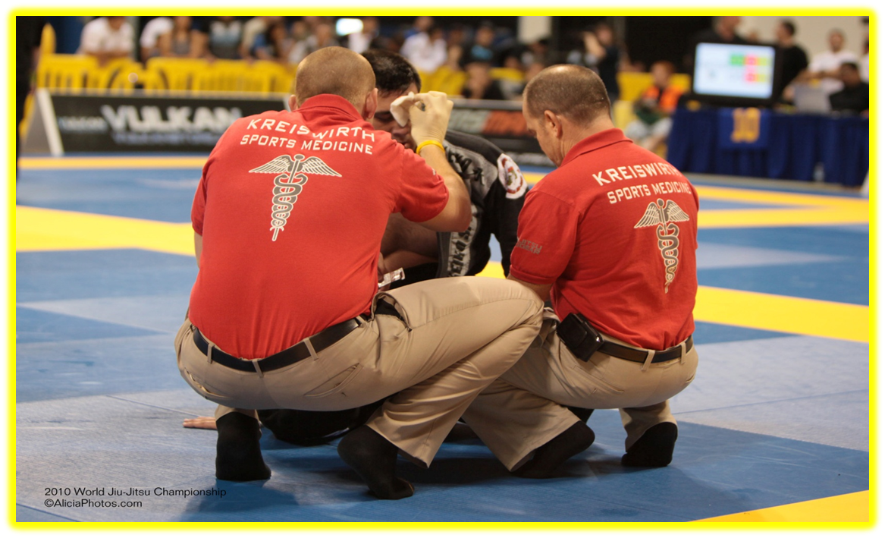
Background and Significance
To date, there is limited published data on injury incidence of BJJ
BJJ tournaments are growing rapidly worldwide in which thousands participate each year
11

Slide 12
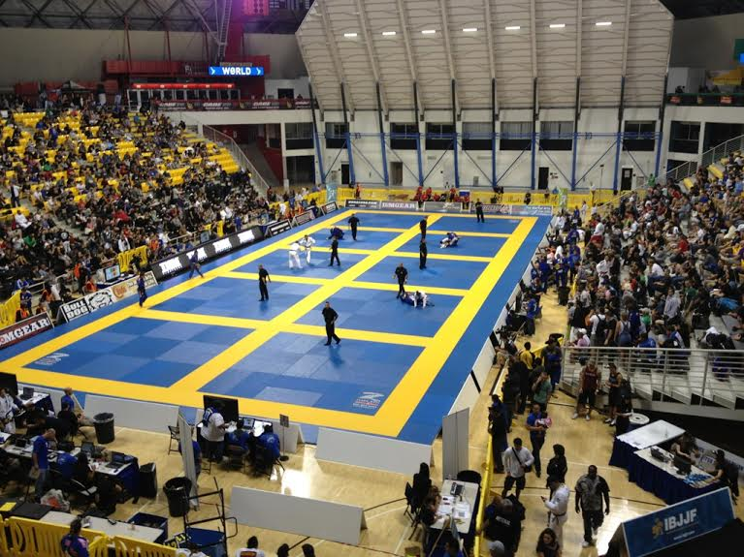
Venue Picture
Medical Area
12

Slide 13
Background and Significance
Since inauguration in the United States, BJJ and its relevance to MMA is one of the fastest growing sports in America, with a consistent 100% annual increase in online interest
Data collection is needed to ascertain injury rates and potential risk factors at a BJJ international tournament competition
BJJ is a gateway to MMA
13

Slide 14
Preliminary Research
The Relationship of Belt Rank Level on the Incidence of Injury in Submission Wrestling at the 2009 Worlds No-Gi Brazilian Jiu Jitsu Championships
Kreiswirth et al. J Athl Train. 2014 Jan-Feb;49(1):89-94.
Cumulative Incidence
Incidence rates by Belt Rank
14

Slide 15
Preliminary Research
Sample Size - 951 fighters
2.5% cumulative incidence
Incidence of joint injury was highest at the knee (7.5/1000 AEs) and elbow (7.5/1000 AEs).

Slide 16
Preliminary No-Gi Research
Joint IR for each belt rank
Blue 21.5/1000 AEs
Purple 21.3/1000 AEs
Brown 25.2/1000 AEs
Black 35.1/1000 AEs
16

Slide 17
Gaps in the Research
No data exists for legal submission holds
Data can be used to expose injury type, frequency, and risk factors during competition/training that may guide evolvement of rules and training strategies.
17

Slide 18
Second Study
Prospective observational cohort design
Larger Sample: 2165 fighters from the 2011 World Brazilian Jiu Jitsu Championship
Pre Event Medical Questionnaire
18

Slide 19
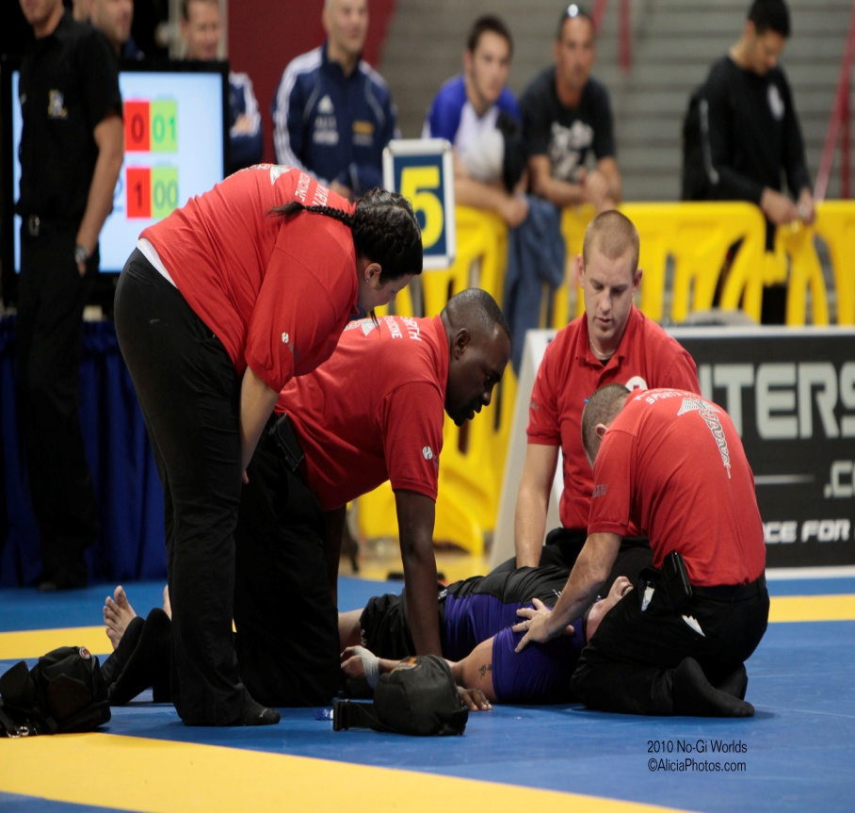
Data Collection
3 ATCs, 1 Physical Therapist, 1 Physician
Sample of 2165: Incidence data collection
Pre-event medical questionnaire
The study approved by RMUoHP IRB
19

Slide 20
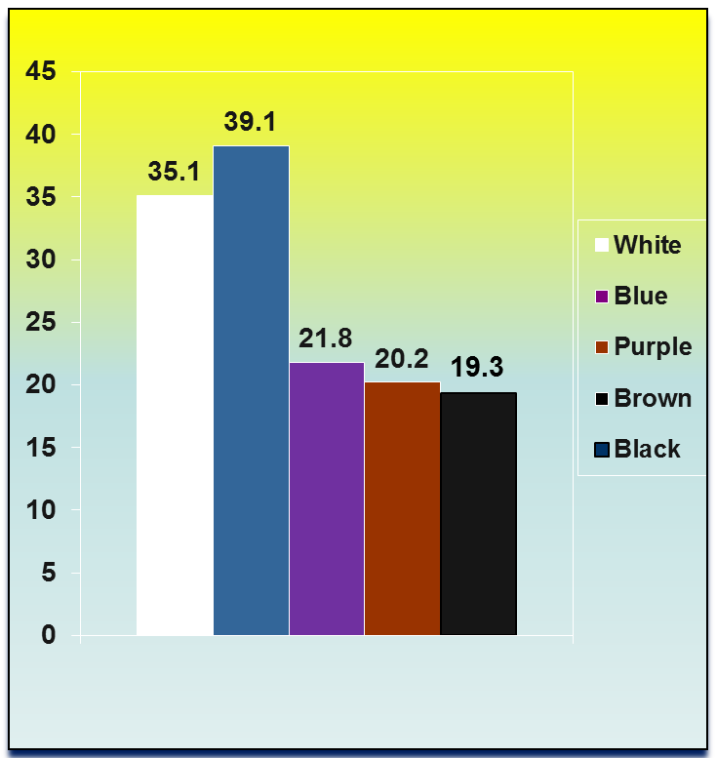
Joint IR for Each Belt Rank
3.9% Cumulative Incidence
White 35.1(95% CI 21.3- 41.9)
Blue 39.1 (95% CI 25.4 – 42.8)
Purple 21.8(95% CI 12.8–30.8)
Brown 20.2 (95%CI 18.3–45.7)
Black 19.3 (95%CI 16.4–39.3)
(P<.05)
20

Slide 21
Joint Injury Frequency
Injury Site | Freq | AE | IR | 95CI | 95CI
Ankle/Toes/Foot | 20 | 4610 | 4.3 | 2.4 | 6.2
Knee | 33 | 4610 | 7.2 | 4.7 | 9.6
Back | 2 | 4610 | 0.4 | -0.2 | 1.03
Ribs | 7 | 4610 | 1.5 | 0.4 | 2.6
Neck | 2 | 4610 | 0.4 | -0.2 | 1.03
Shoulder | 20 | 4610 | 4.3 | 2.4 | 6.2
Elbow | 48 | 4610 | 10.4 | 7.5 | 13.3
Wrist/Hand/Finger | 10 | 4610 | 2.2 | 0.8 | 3.5
Hip/Pelvis | 1 | 4610 | 0.2 | -0.2 | 0.6
21

Slide 22
New Injury During 2011 World BJJ Championships
Injury | n | AE | Rate | IRR | 95CI
Yes | 111 | 4610 | 24.1 | 3.1 | 2.8,4.0
No | 36 | 4610 | 7.8 | 1.0 | 0.8,1.4
22

Slide 23
Injury Incidence by Gender
Gender | N | AE | IR | 95CI | 95CI
F | 26 | 844 | 30.8 | 19.2 | 42.5
M | 121 | 3766 | 32.1 | 26.5 | 37.8
23

Slide 24
Summary Findings
First large scale epidemiological report of a new sport
Elbow joint highest incidence
Blue Belt (less experienced) level most injured
No significant differences among gender
3 times more likely to incur injury at BJJ event
24

Slide 25
Lessons Learned
Ligamentous concerns
  ACL / MCL / LCL
Joint concerns
  Posterolateral corner
Muscle / tendon concerns
  Biceps / Triceps
Malnutrition/Dehydration concerns
Psychosomatic episodes
Auricular hematomas and Tx

Slide 26
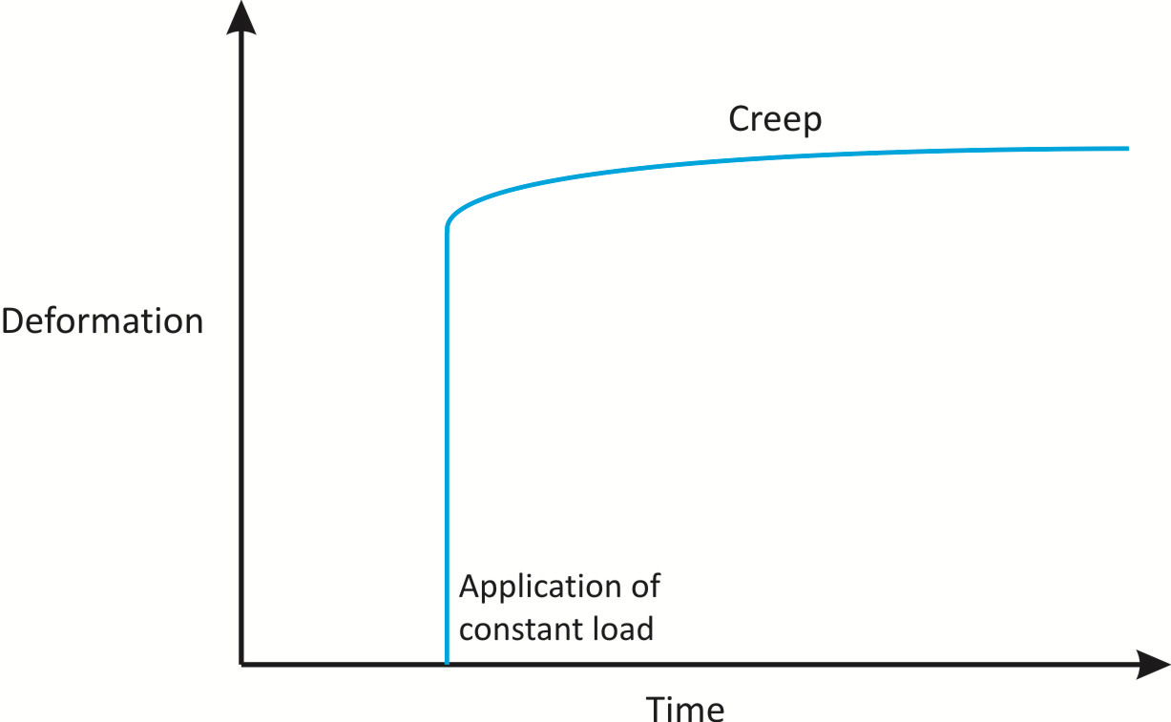
Tissue Creep
a physical property of materials that results in progressive deformation when a constant load is applied over time; it allows soft tissues to tolerate applied loads by lengthening.
-Medical dictionary

Slide 27
Ligamentous Concerns
Lower Extremity
Upper extremity
Ankle
  ATFL
    PF/Inv or Toe hold
Knee
  ACL
    Standing pivot, defending, knee bar
  MCL
    Valgus
  LCL
    Varus
  PCL
    Hyperextension
Shoulder
  GH Capsule / Labrum
    Kimura or Americana
Elbow
  UCL
    Hyperextension lock / Arm bar
Wrist
  TFCC
    FOOSH

Slide 28
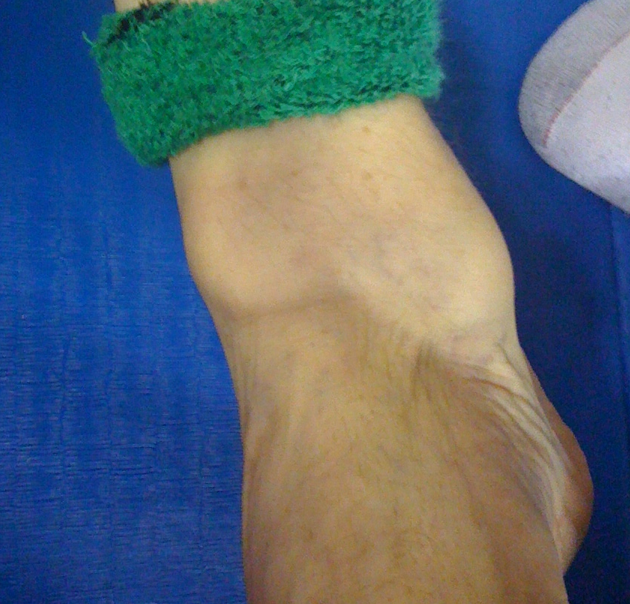

Slide 29
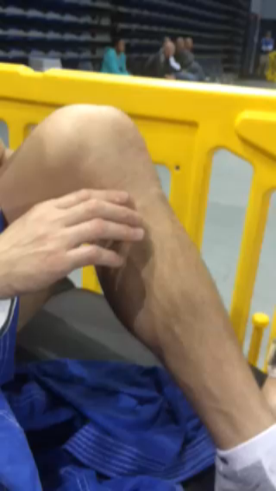

Slide 30
Joint Concerns
Posterolateral corner
  Posterior arcuate ligament
  LCL
  MOI – Hyperextension with or without IR of tibia

Slide 31
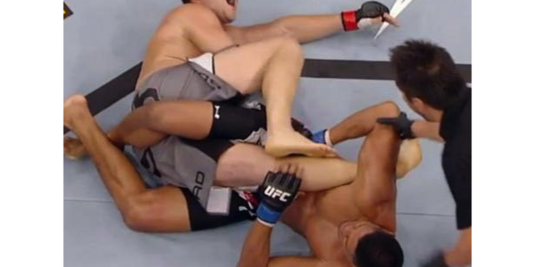
http://bleacherreport.com/articles/1795019-ufc-fight-night-29-preview-and-predictions-for-every-single-fight

Slide 32
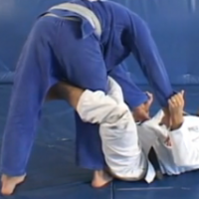

Slide 33
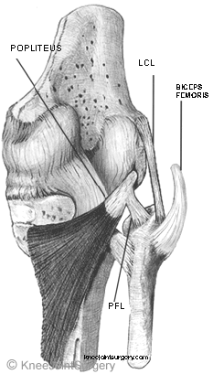

Slide 34
Muscle / Tendon Concerns
Ruptures and Tears
  Biceps: Proximal and Distal tendons
  Triceps: Distal

Slide 35
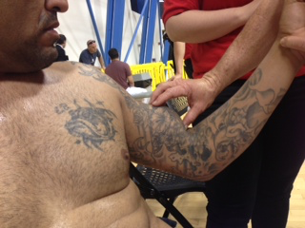
Proximal Biceps Tendon Rupture

Slide 36
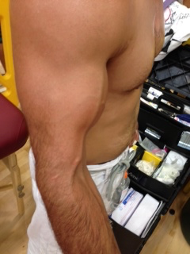
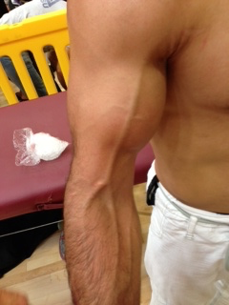
Distal Biceps Tendon Rupture

Slide 37
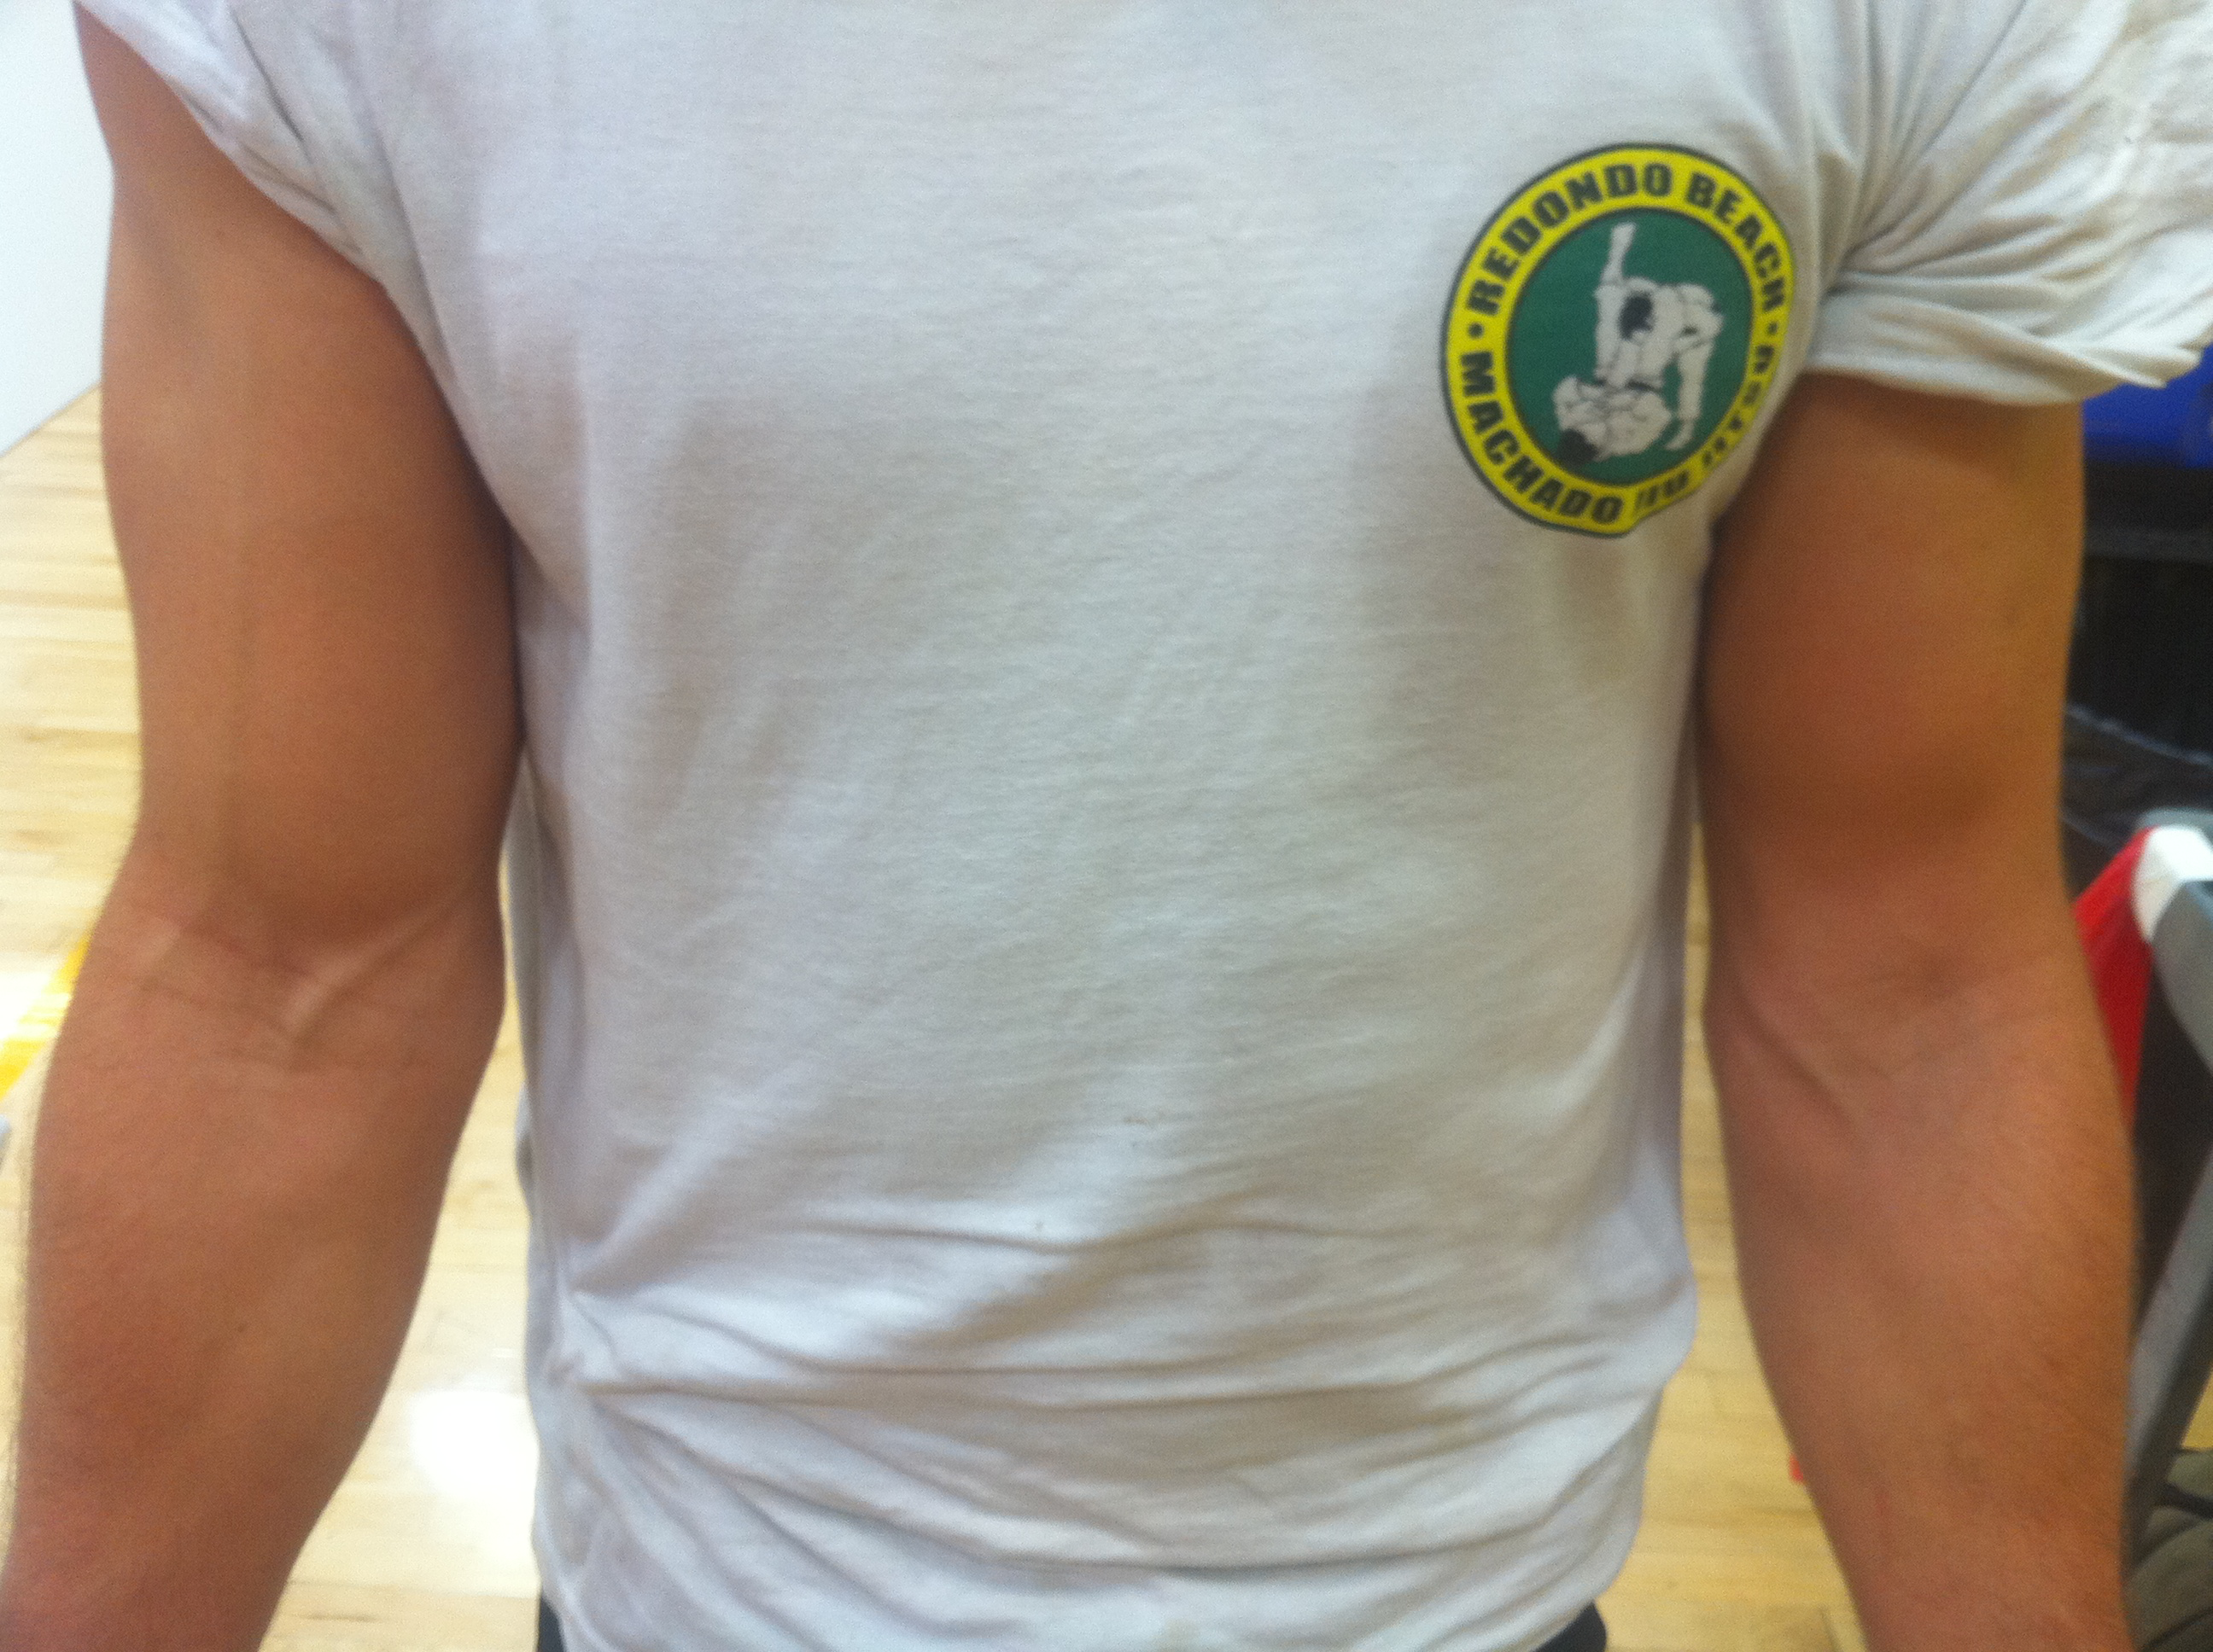

Slide 38
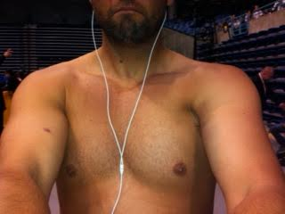
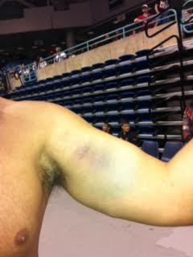

Slide 39
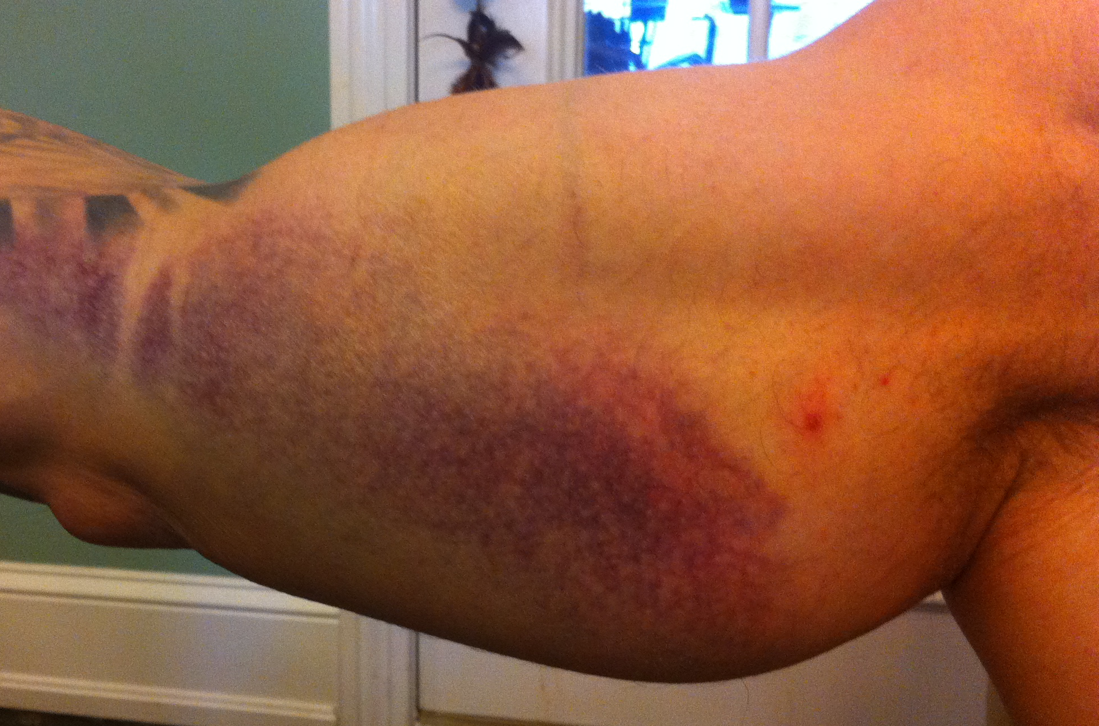

Slide 40
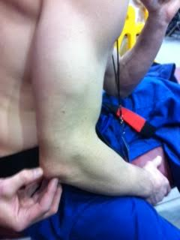
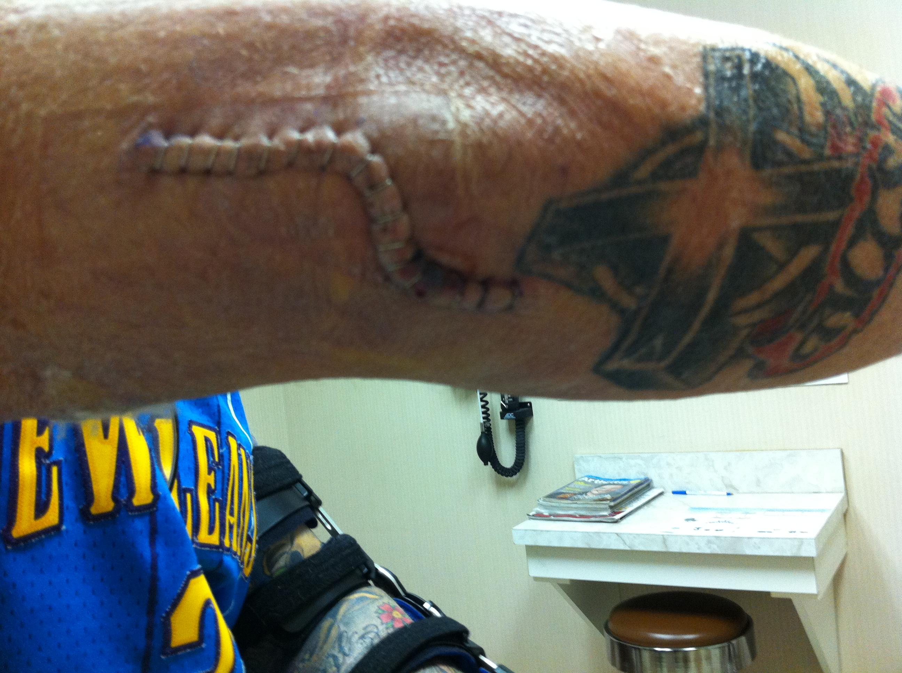
Distal Triceps Tendon Rupture

Slide 41
Malnutrition / Dehydration
Weigh in occurs 5 – 15mins before competition starts
Gi weighs about 3 pounds
Weight usually cut within 1 – 2 weeks of tournament
No time to replenish what has been lost

Slide 42
Fluid Loss / Dehydration
Performance effected with 1-3% BW loss
3-5 beats/min increase with every 1 % H20 loss
Na and Cl lost in sweat
NATA position statements includes frequent breaks and exposure to fluids to prevent loss.

Slide 43
Psychosomatic Episodes
Anxiety of large competition
In children, heavily influenced by their parents
  May not be ready for high level competition
Self-esteem concerns

Slide 44
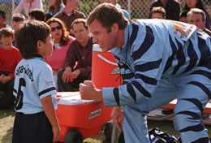

Slide 45
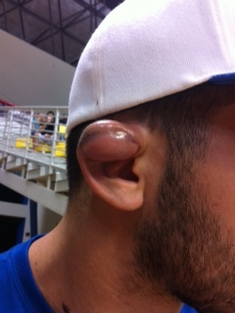
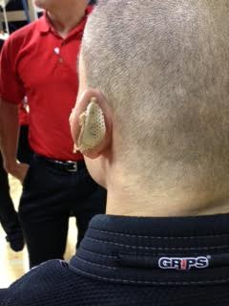
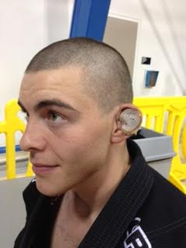
Auricular Hematoma

Slide 46
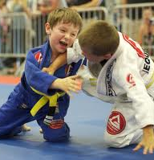
Age Considerations
Youth development
Intensity
Low injury rates
Increased emotional distress

Slide 47
Considerations
Muscle tendon issues increase risk of injury with age
Early recognition
Impact of a good Hx, MOI, supplementation
We've had excellent follow up – triage and provide management
Educate and refer

Slide 48
Conclusions
BJJ is novel in MOI and over all mat time compared to other grappling sports
ATC must be able to recognize MOI and injury for rapid assessment and clinical DX

Slide 49
Conclusions
Epi in a new sport
One of the first reports of BJJ incidence
Future research is warranted to understand safety of training methods
Referee’s experience of recognition of terminal end range
IBJJF Medical/Referee training injury management

Slide 50
Take Home Message
Having qualified medical coverage; Certified Athletic Trainers is paramount to recognition of injury.

Slide 51
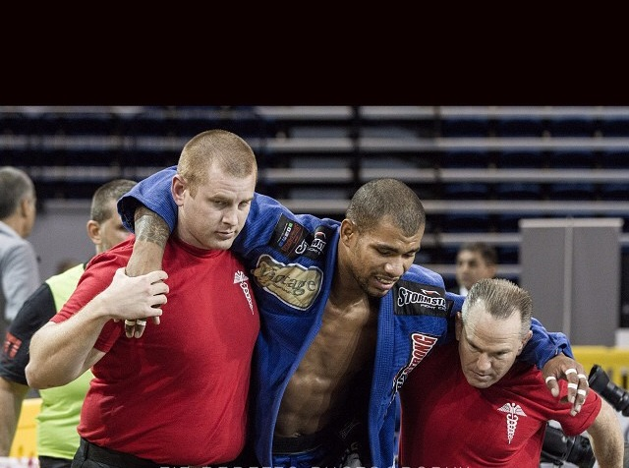
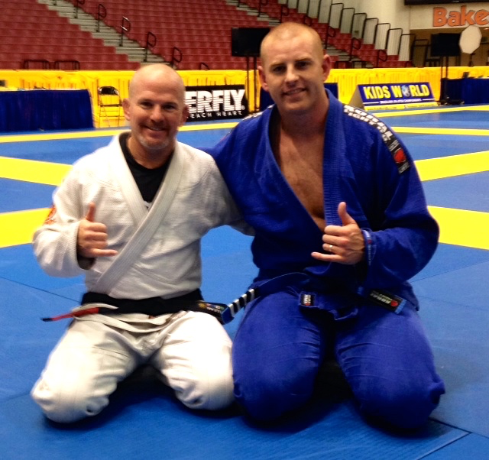
Thank you!

